Slide 1
Data Science Chapter 2: Statistical Analysis, Exploratory Data Analysis and Data Science Process

Slide 2
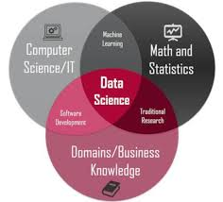
Refreshing..
What is Big data and data Science?
Why DS now?
Data Science is a combination of…..

Slide 3
For a Data Scientist
Foundational knowledge
Statistics
Linear Algebra
Some Programming
Skill sets in Data Science
Data Preparation & Munging
modeling
Coding
Visualization
Communication

Slide 4
Why study Statistics?
Data are everywhere – examples…
Statistical techniques are used to make many decisions that affect our lives. Live examples..
No matter what your career, you will make professional decisions that involve data. An understanding of statistical methods will help you make these decisions efectively

Slide 5
Applications of statistical concepts in the business world
Finance – correlation and regression, index numbers, time series analysis
Marketing – hypothesis testing, chi-square tests, nonparametric statistics
Personel – hypothesis testing, chi-square tests, nonparametric tests
Operating management – hypothesis testing, estimation, analysis of variance, time series analysis

Slide 6
Statistics
The science of collecting, organizing, presenting, analyzing, and interpreting data to assist in making more effective decisions
Statistical analysis – used to manipulate summarize, and investigate data, so that useful decision-making information results.
It’s a process of going from world to data and from data to world. Statistic Inference

Slide 7
Types of Statistics
Descriptive statistics – Methods of organizing, summarizing, and presenting data in an informative way
Inferential statistics – The methods used to determine something about a population on the basis of a sample
Population –The entire set of individuals or objects of interest or the measurements obtained from all individuals or objects of interest
Sample – A portion, or part, of the population of interest

Slide 8
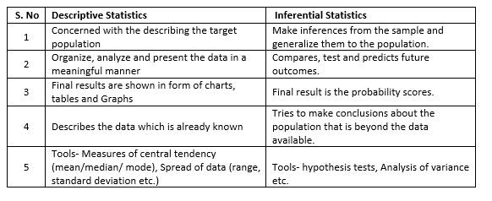

Slide 9
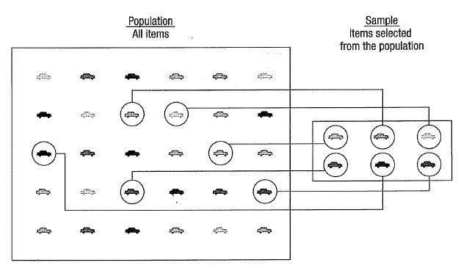

Slide 10
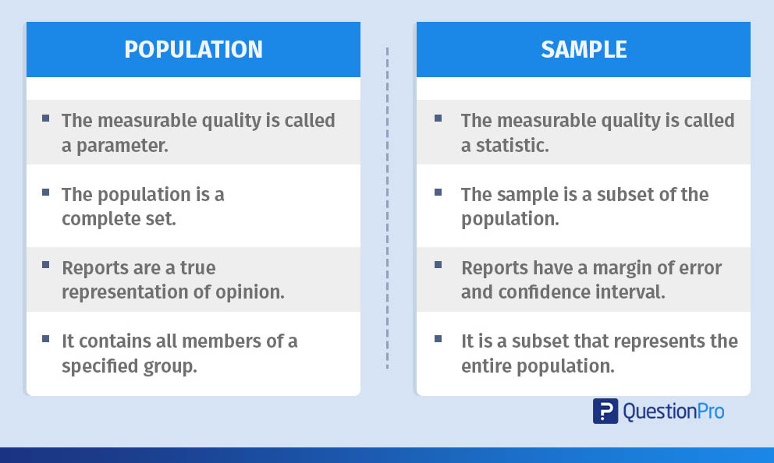
Population & Samples

Slide 11
Types Inferential Statistics
Estimation
e.g., Estimate the population mean weight using the sample mean weight
Hypothesis testing
e.g., Test the claim that the population mean weight is 70 kg
Inference is the process of drawing conclusions or making decisions about a population based on sample results

Slide 12
Sampling
A sample should have the same characteristics
as the population it is representing.
Sampling can be:
with replacement: a member of the population may be chosen more than once (picking the candy from the bowl)
without replacement: a member of the population may be chosen only once (lottery ticket)

Slide 13
Sampling Methods
Sampling methods can be:
random (each member of the population has an equal chance of being selected)
Non-random The actual process of sampling causes sampling errors. For example, the sample may not be large enough or representative of the population. Factors not related to the sampling process cause non-sampling errors. A defective counting device can cause a non-sampling error.

Slide 14
Sampling Methods
simple random sample (each sample of the same size has an equal chance of being selected)
stratified sample (divide the population into groups called strata and then take a sample from each stratum)
cluster sample (divide the population into strata and then randomly select some of the strata. All the members from these strata are in the cluster sample.)
systematic sample (randomly select a starting point and take every n-th piece of data from a listing of the population)

Slide 15
Descriptive Statistics
Collect data
e.g., Survey
Present data
e.g., Tables and graphs
Summarize data
e.g., Sample mean =

Slide 16
Statistical Data
The collection of data that are relevant to the problem being studied is commonly the most difficult, expensive, and time-consuming part of the entire research project.
Statistical data are usually obtained by counting or measuring items.
Primary data are collected specifically for the analysis desired
Secondary data have already been compiled and are available for statistical analysis
A variable is an item of interest that can take on many different numerical values.
A constant has a fixed numerical value.

Slide 17
Data Generating Process
Data Gathering Methods
Observation and Recording
Experts Suggestion
Feedback Mechanism
Data represents the traces of the real-world processes. This represents data collection or sampling method.
Observer information converted into data. Thus it is subjective process, not objective.
Uncertainty and Randomness associated with underlying data collection process itself.

Slide 18
Most data can be put into the following categories:
Qualitative - data are measurements that each fall into one of several categories. (hair color, ethnic groups and other attributes of the population)
Quantitative - data are observations that are measured on a numerical scale (distance traveled to college, number of children in a family, etc.)

Slide 19
Qualitative Data
Qualitative data are generally described by words or
letters. They are not as widely used as quantitative data
because many numerical techniques do not apply to the
qualitative data. For example, it does not make sense to
find an average hair color or blood type.
Qualitative data can be separated into two subgroups:
dichotomic (if it takes the form of a word with two options (gender - male or female)
polynomic (if it takes the form of a word with more than two options (education - primary school, secondary school and university).

Slide 20
Quantitative Data
Quantitative data are always numbers and are the
result of counting or measuring attributes of a population.
Quantitative data can be separated into two
subgroups:
discrete (if it is the result of counting (the number of students of a given ethnic group in a class, the number of books on a shelf, ...)
continuous (if it is the result of measuring (distance traveled, weight of luggage, …)

Slide 21
Types of Variables
Variables
Qualitative
Quantitative
Dichotomic
Polynomic
Discrete
Continuous
Gender, marital status
Brand of Pc, hair color
Children in family, Strokes on a golf hole
Amount of income tax paid, weight of a student

Slide 22
Numerical Scale of Measurement
Nominal – consist of categories in each of which the number of respective observations is recorded. The categories are in no logical order and have no particular relationship. The categories are said to be mutually exclusive since an individual, object, or measurement can be included in only one of them.
Ordinal – contain more information. Consists of distinct categories in which order is implied. Values in one category are larger or smaller than values in other categories (e.g. rating-excelent, good, fair, poor)
Interval – is a set of numerical measurements in which the distance between numbers is of a known, sonstant size.
Ratio – consists of numerical measurements where the distance between numbers is of a known, constant size, in addition, there is a nonarbitrary zero point.

Slide 23
Population and samples of Big Data
Sampling solves some engineering challenges.
Bias : Uncertainty in sampling: sample distribution.
Simplifying assumptions
Big is when we cannot fit it on one machine
Big Data is a cultural phenomenon
4 v`s. Volume, variety, velocity and value.

Slide 24
Exploratory Data Analysis
is the first step in your data analysis process developed by “John Tukey” in the 1970s.
is an approach to analyzing data sets to summarize their main characteristics, often with visual methods.
Ex: You are planning to go on a trip to the “X” location. Things you do before taking a decision:
You will explore the location on what all places, waterfalls, trekking, beaches, restaurants that location has in Google, Instagram, Facebook, and other social Websites.
Calculate whether it is in your budget or not.
Check for the time to cover all the places.
Type of Travel method.
Similarly, when you are trying to build a machine learning model you need to be pretty sure whether your data is making sense or not. The main aim of exploratory data analysis is to obtain confidence in your data to an extent where you’re ready to engage a machine learning algorithm.

Slide 25
Need For Exploratory Data Analysis
its feature can be used for supervised and unsupervised machine learning modeling.
you will have many plots, heat-maps, frequency distribution, graphs, correlation matrix along with the hypothesis by which any individual can understand what your data is all about and what insights you got from exploring your data set.
“A Plot is worth a thousand rows“
EX: Trip data.
They can be two: informative or operative.

Slide 26
Applying EDA
Step 1 - First approach to data
Step 2 - Analyzing categorical variables
Step 3 - Analyzing numerical variables
Step 4 - Analyzing numerical and categorical at the same time
Covering some key points in a basic EDA:
Data types
Outliers
Missing values
Distributions (numerically and graphically) for both, numerical and categorical variables.

Slide 27
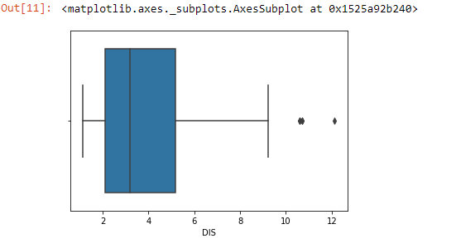
What Are The Steps in EDA
Description of data
Handling missing data
Drop NULL or missing values
Fill Missing Values
Predict Missing values with an ML Algorithm
Handling outliers
BoxPlot
Scatterplot
Z-score
IQR(Inter-Quartile Range)
Understanding relationships and new insights through plots

Slide 28
Steps of EDA
)
data=heart_disease %>% select(age, max_heart_rate, thal, has_heart_disease)
Description of data
glimpse(data)
## Observations: 303
## Variables: 4
## $ age <int> 63, 67, 67, 37, 41, 56, 62, 57, 63, 53, 57, ...
## $ max_heart_rate <int> 150, 108, 129, 187, 172, 178, 160, 163, 147,...
## $ thal <fct> 6, 3, 7, 3, 3, 3, 3, 3, 7, 7, 6, 3, 6, 7, 7,...
## $ has_heart_disease <fct> no, yes, yes, no, no, no, yes, no, yes, yes,...

Slide 29
status(data)
## variable q_zeros p_zeros q_na p_na q_inf p_inf type unique
## 1 age 0 0 0 0.0000 0 0 integer 41
## 2 max_heart_rate 0 0 0 0.0000 0 0 integer 91
## 3 thal 0 0 2 0.0066 0 0 factor 3
## 4 has_heart_disease 0 0 0 0.0000 0 0 factor 2
status returns a table, that match certain conditions like: + Having at least 80% of non-NA values (p_na< 0.2) + Having less than 50 unique values (unique <= 50)
Are all the variables in the correct data type?
Variables with lots of zeros or NAs?
Any high cardinality variable?

Slide 30
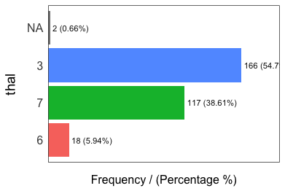
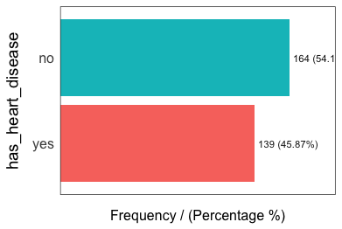
Freq(data)
## thal frequency percentage cumulative_perc
## 1 3 166 54.79 55
## 2 7 117 38.61 93
## 3 6 18 5.94 99
## 4 <NA> 2 0.66 100
## has_heart_disease frequency percentage cumulative_perc
## 1 no 164 54 54
## 2 yes 139 46 100

Slide 31
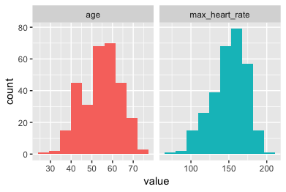
plot_num(data)
data_prof=profiling_num(data)
## variable mean std_dev variation_coef
p_01 p_05 p_25 p_50 p_75 p_95
## 1 age 54 9 0.17 35 40 48 56 61 68
## 2 max_heart_rate 150 23 0.15 95 108 134 153 166 182 ## p_99 skewness kurtosis iqr range_98 range_80
## 1 71 -0.21 2.5 13 [35, 71] [42, 66]
## 2 192 -0.53 2.9 32 [95.02, 191.96] [116, 176.6]
Try to describe each variable based on its distribution (also useful for reporting)
Pay attention to variables with high standard deviation.
Select the metrics that you are most familiar with: data_prof %>% select(variable, variation_coef, range_98): A high value in variation_coef may indictate outliers. range_98 indicates where most of the values are.

Slide 32
## data
## 4 Variables 303 Observations
## ---------------------------------------------------------------------------
## age
## n missing distinct Info Mean Gmd .05 .10
## 303 0 41 0.999 54.44 10.3 40 42
## .25 .50 .75 .90 .95
## 48 56 61 66 68
## lowest : 29 34 35 37 38, highest: 70 71 74 76 77
## ---------------------------------------------------------------------------
## max_heart_rate
## n missing distinct Info Mean Gmd .05 .10
## 303 0 91 1 149.6 25.73 108.1 116.0
## .25 .50 .75 .90 .95
## 133.5 153.0 166.0 176.6 181.9
## lowest : 71 88 90 95 96, highest: 190 192 194 195 202
## ---------------------------------------------------------------------------
## thal
## n missing distinct
## 301 2 3
## Value 3 6 7
## Frequency 166 18 117
## Proportion 0.55 0.06 0.39
## ---------------------------------------------------------------------------
## has_heart_disease
## n missing distinct library(Hmisc) describe(data)
## 303 0 2
##
## Value no yes
## Frequency 164 139
## Proportion 0.54 0.46
## ---------------------------------------------------------------------------

Slide 33
There are plenty of open-source tools exist which automate the steps of predictive modeling like data cleaning, data visualization. Some of them are also quite popular like Excel, Tableau, Qlikview, Weka and many more apart from the programming.
In programming, we can accomplish EDA using Python, R, SAS.
hurry to get to the machine learning stage,
many implications, including generating inaccurate models,
generating accurate models but on the wrong data,
not creating the right types of variables in data preparation,
using resources inefficiently because of realizing only after generating models that perhaps the data is skewed, or has outliers, or has too many missing values, or finding that some values are inconsistent.

Slide 34
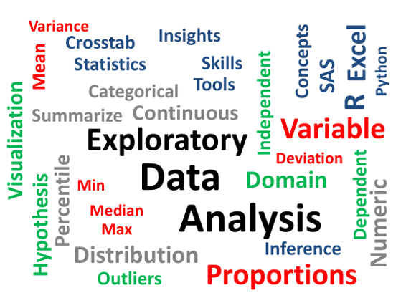

Slide 35
Data Science process
The power of data science comes from a deep understanding of statistics and algorithms, programming and hacking, and communication skills.
“What kinds of data challenges do you think I should be working on?”
“Can you help us optimize our sales funnel and improve our conversion rates?”
What? Is that a data science problem? You didn’t even mention the word ‘data’. What do I need to analyze? What does this mean?

Slide 36
The data science process: a quick outline
Frame the problem
Collect the raw data needed to solve the problem:
Process the data (data wrangling)
Explore the data
Perform in-depth analysis (machine learning, statistical models, algorithms)
Communicate results of the analysis

Slide 37
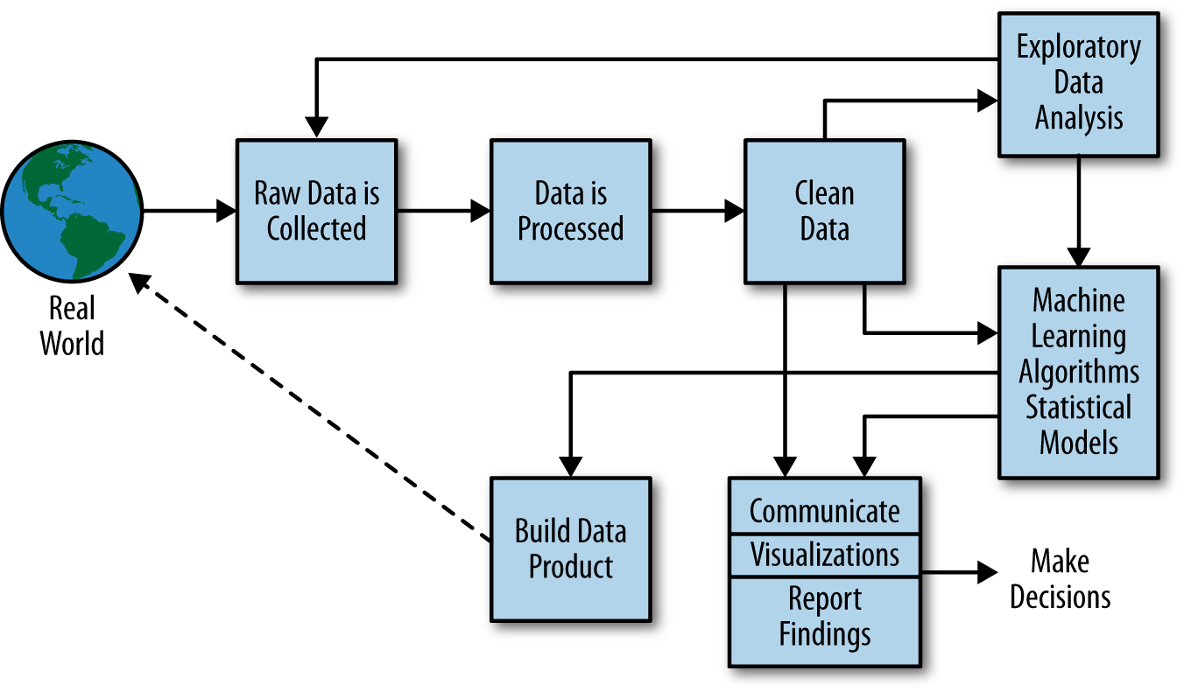
Data Science Process

Slide 38
Step 1 of 6. Frame the problem
You start by asking a lot of questions.
Who are the customers, and how do you identify them?
What does the sales process look like right now?
What kind of information do you collect about potential customers?
What are the different tiers of service right now?
“I feel like my sales team is spending a lot of time chasing down customers who won’t buy the product. I’d rather they spent their time with customers who are likely to convert. I also want to figure out if there are customer segments who are not converting well and figure out why that is.”

Slide 39
What are some important customer segments?
How do conversion rates differ across these segments? Do some segments perform significantly better or worse than others?
How can we predict if a prospective customer is going to buy the product?
Can we identify customers who might be on the fence?
What is the return on investment (ROI) for different kinds of customers?
“I’m particularly interested in having a sense of how likely a customer is to convert. The other questions are pretty interesting too!”

Slide 40
Step 2 of 6: Collect the right data
Now’s the time to start thinking about data. What data do you have available to you?
What data from the CRM database do you need? How should you extract it? What format should you store the data in to perform your analysis?
an ethical data scientist concerned with both security and privacy..
Are you ready to start diving into it and cranking out insights? Not yet

Slide 41
Step 3 of 6: How to process your data
Data cleaning and wrangling often takes up the bulk of time in a data scientist’s day-to-day work, and it’s a step that requires patience and focus.
Are there missing values i.e. are there customers without a first contact date? If not, why not? Is that a good or a bad thing?
What’s the time zone represented by these values? Do all the entries represent the same time zone?
What is the date range? Is the date range valid? For example, if hotshot.io has been around since 2011, are there dates before 2011? Do they mean anything special or are they mistakes? It might be worth verifying the answer with a member of the sales team.

Slide 42
Step 4 of 6: Explore your data
now, you’re finally ready to dive into the data!
predict which future prospects are likely to convert. What if you split the data into two segments based on whether the customer converted or not and examine differences between the two groups?
When you plot the age distributions of customers on a histogram for the two categories, you notice that there are a large number of customers in their early 30s who seem to buy the product and far fewer customers in their 20s. This is surprising, since the product targets people in their 20s.

Slide 43
Step 5 of 6: Analyze Your Data In Depth
A machine learning model takes a set of data points, where each data point is expressed as a feature vector.
How do you come up with these feature vectors?
Ex: age is a numeric value whereas marketing method is a categorical value.
you have features and labels, you decide to use a simple machine learning classifier algorithm called logistic regression.
“Yes, the predictive model I created with logistic regression has a TPR of 95% and an FPR of 0.5%!”
communicate your results to your client in a way that is compelling and comprehensible for them.

Slide 44
Step 6 of 6: Visualize and Communicate Your Findings
how do you convey its awesomeness to your client, the VP of Sales? How do you present your results to her in a form that she can use?
you want the story to answer the questions that are most important to your client!
Age: We’re selling a lot more to prospects in their early 30s, rather than those in their mid-20s. This is unexpected since our product is targets people in their mid-20s!
Marketing methods: We use social media marketing to target people in their 20s, but email campaigns to people in their 30s. This appears to be a significant factor behind the difference in conversion rates.

Slide 45
recommend using the spreadsheet with prospect predictions for the next week or two to focus on the most likely targets and see how well that performs. That’ll make your sales team more productive right away, and tell me if the predictive model needs more fine-tuning.
Second, we should also look into what’s happening with our marketing and figure out whether we should be targeting the mid-20s crowd with email campaigns, or making our social media campaigns more effective.”

Slide 46
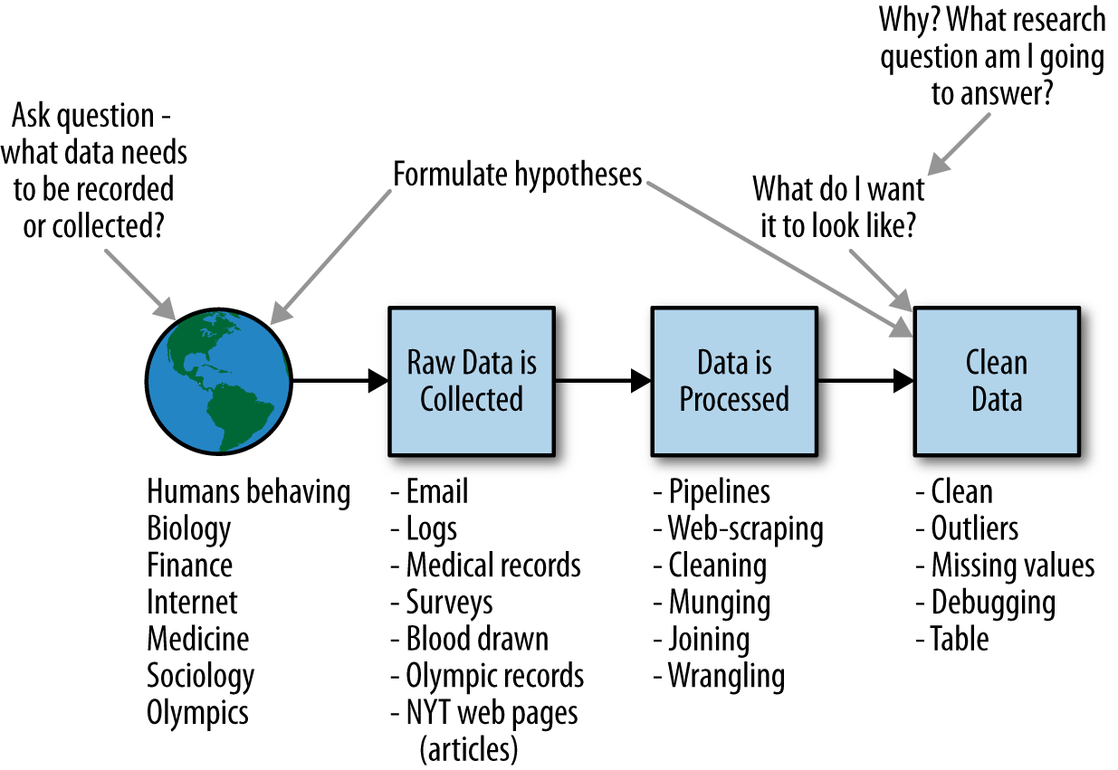
Data Scientist Role

Slide 47
Data Scientists
They find stories, extract knowledge. They are not reporters
Data scientists are the key to realizing the opportunities presented by big data. They bring structure to it, find compelling patterns in it, and advise executives on the implications for products, processes, and decisions

Slide 48
What do they do?
National Security
Cyber Security
Business Analytics
Engineering
Healthcare
And more ….

Slide 49
Three Recurring Data Scientist Activities
Reframe business challenges as analytics challenges
Design, implement, and deploy statistical models and data mining techniques on Big Data
Develop insights that lead to actionable recommendations

Slide 50
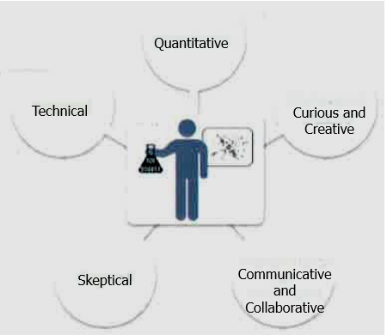
Profile of Data Scientist Five Main Sets of Skills

Slide 51
Profile of Data Scientist Five Main Sets of Skills
Quantitative skill – e.g., math, statistics
Technical aptitude – e.g., software engineering, programming
Skeptical mindset and critical thinking – ability to examine work critically
Curious and creative – passionate about data and finding creative solutions
Communicative and collaborative – can articulate ideas, can work with others

Slide 52
Data science projects differ from BI projects
More exploratory in nature
Critical to have a project process
Participants should be thorough and rigorous
Break large projects into smaller pieces
Spend time to plan and scope the work
Documenting adds rigor and credibility

Slide 53
Data Analytics Lifecycle
Data Analytics Lifecycle Overview
Phase 1: Discovery
Phase 2: Data Preparation
Phase 3: Model Planning
Phase 4: Model Building
Phase 5: Communicate Results
Phase 6: Operationalize

Slide 54
Data Analytics Lifecycle Overview
The data analytic lifecycle is designed for Big Data problems and data science projects
With six phases the project work can occur in several phases simultaneously
The cycle is iterative to portray a real project
Work can return to earlier phases as new information is uncovered

Slide 55
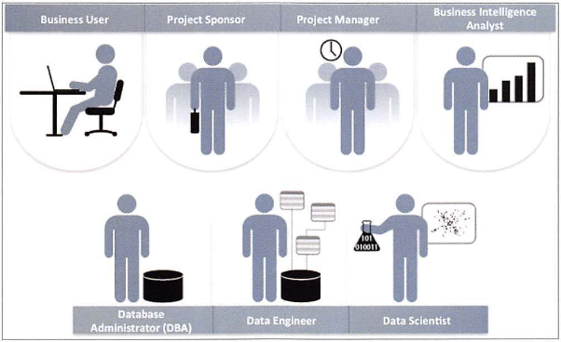
Key Roles for a Successful Analytics Project

Slide 56
Key Roles for a Successful Analytics Project
Business User – understands the domain area
Project Sponsor – provides requirements
Project Manager – ensures meeting objectives
Business Intelligence Analyst – provides business domain expertise based on deep understanding of the data
Database Administrator (DBA) – creates DB environment
Data Engineer – provides technical skills, assists data management and extraction, supports analytic sandbox
Data Scientist – provides analytic techniques and modeling

Slide 57
Background and Overview of Data Analytics Lifecycle
Data Analytics Lifecycle defines the analytics process and best practices from discovery to project completion
The Lifecycle employs aspects of
Scientific method
Cross Industry Standard Process for Data Mining (CRISP-DM)
Process model for data mining
Davenport’s DELTA framework
Hubbard’s Applied Information Economics (AIE) approach
MAD Skills: New Analysis Practices for Big Data by Cohen et al.

Slide 58
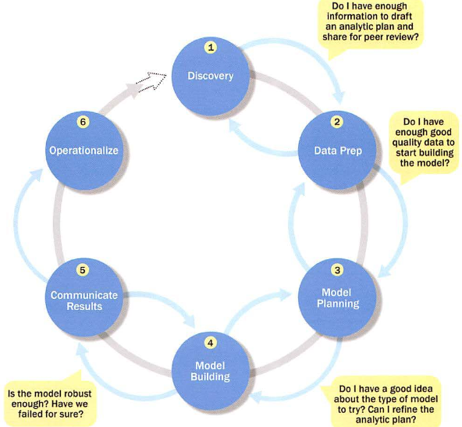
Overview of Data Analytics Lifecycle

Slide 59
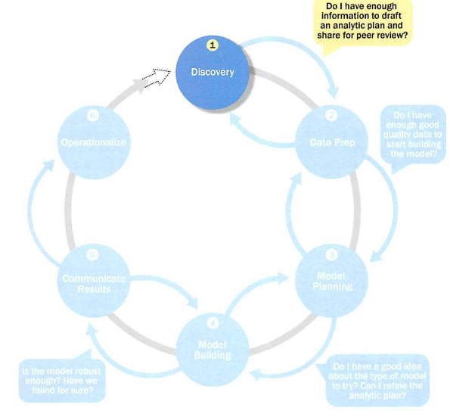
Phase 1: Discovery

Slide 60
Phase 1: Discovery
Learning the Business Domain
Resources
Framing the Problem
Identifying Key Stakeholders
Interviewing the Analytics Sponsor
Developing Initial Hypotheses
Identifying Potential Data Sources

Slide 61
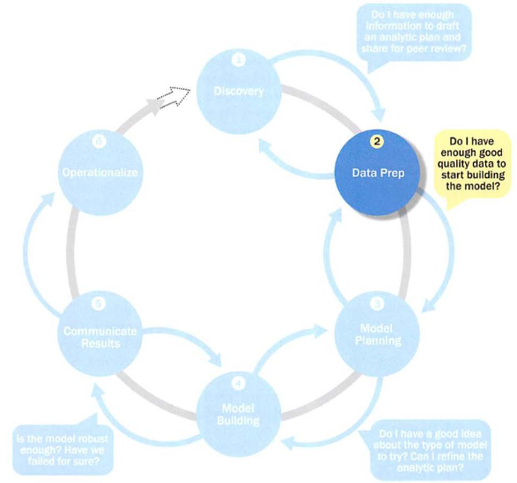
Phase 2: Data Preparation

Slide 62
Phase 2: Data Preparation
Includes steps to explore, preprocess, and condition data
Create robust environment – analytics sandbox
Data preparation tends to be the most labor-intensive step in the analytics lifecycle
Often at least 50% of the data science project’s time
The data preparation phase is generally the most iterative and the one that teams tend to underestimate most often

Slide 63
Preparing the Analytic Sandbox
Create the analytic sandbox (also called workspace)
Allows team to explore data without interfering with live production data
Sandbox collects all kinds of data (expansive approach)
The sandbox allows organizations to undertake ambitious projects beyond traditional data analysis and BI to perform advanced predictive analytics
Although the concept of an analytics sandbox is relatively new, this concept has become acceptable to data science teams and IT groups

Slide 64
Performing ETLT (Extract, Transform, Load, Transform)
In ETL users perform extract, transform, load
In the sandbox the process is often ELT – early load preserves the raw data which can be useful to examine
Example – in credit card fraud detection, outliers can represent high-risk transactions that might be inadvertently filtered out or transformed before being loaded into the database
Hadoop is often used here

Slide 65
Learning about the Data
Becoming familiar with the data is critical
This activity accomplishes several goals:
Determines the data available to the team early in the project
Highlights gaps – identifies data not currently available
Identifies data outside the organization that might be useful

Slide 66
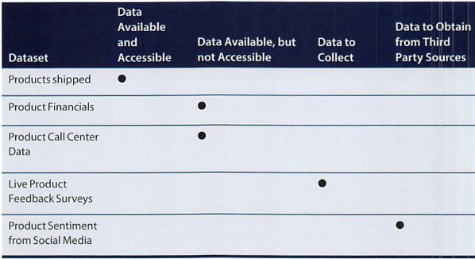
Learning about the Data Sample Dataset Inventory

Slide 67
Data Conditioning
Data conditioning includes cleaning data, normalizing datasets, and performing transformations
Often viewed as a preprocessing step prior to data analysis, it might be performed by data owner, IT department, DBA, etc.
Best to have data scientists involved
Data science teams prefer more data than too little

Slide 68
Data Conditioning
Additional questions and considerations
What are the data sources? Target fields?
How clean is the data?
How consistent are the contents and files? Missing or inconsistent values?
Assess the consistence of the data types – numeric, alphanumeric?
Review the contents to ensure the data makes sense
Look for evidence of systematic error

Slide 69
Survey and Visualize
Leverage data visualization tools to gain an overview of the data
Shneiderman’s mantra:
“Overview first, zoom and filter, then details-on-demand”
This enables the user to find areas of interest, zoom and filter to find more detailed information about a particular area, then find the detailed data in that area

Slide 70
Survey and Visualize Guidelines and Considerations
Review data to ensure calculations are consistent
Does the data distribution stay consistent?
Assess the granularity of the data, the range of values, and the level of aggregation of the data
Does the data represent the population of interest?
Check time-related variables – daily, weekly, monthly? Is this good enough?
Is the data standardized/normalized? Scales consistent?
For geospatial datasets, are state/country abbreviations consistent

Slide 71
Common Tools for Data Preparation
Hadoop can perform parallel ingest and analysis
Alpine Miner provides a graphical user interface for creating analytic workflows
OpenRefine (formerly Google Refine) is a free, open source tool for working with messy data
Similar to OpenRefine, Data Wrangler is an interactive tool for data cleansing and transformation

Slide 72
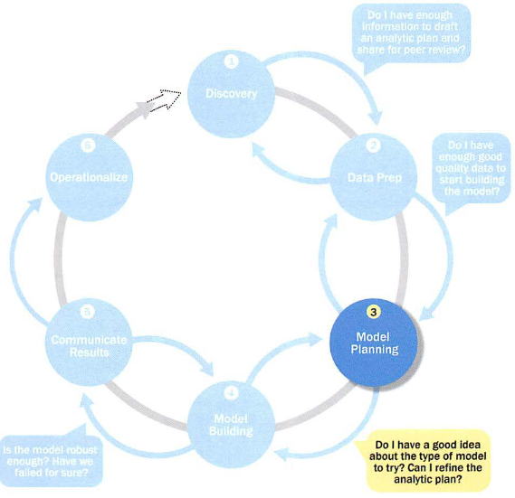
Phase 3: Model Planning

Slide 73
Phase 3: Model Planning
Activities to consider
Assess the structure of the data – this dictates the tools and analytic techniques for the next phase
Ensure the analytic techniques enable the team to meet the business objectives and accept or reject the working hypotheses
Determine if the situation warrants a single model or a series of techniques as part of a larger analytic workflow
Research and understand how other analysts have approached this kind or similar kind of problem

Slide 74
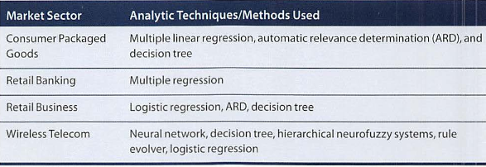
Phase 3: Model Planning Model Planning in Industry Verticals
Example of other analysts approaching a similar problem

Slide 75
Data Exploration and Variable Selection
Explore the data to understand the relationships among the variables to inform selection of the variables and methods
A common way to do this is to use data visualization tools
Often, stakeholders and subject matter experts may have ideas
For example, some hypothesis that led to the project
Aim for capturing the most essential predictors and variables
This often requires iterations and testing to identify key variables
If the team plans to run regression analysis, identify the candidate predictors and outcome variables of the model

Slide 76
Model Selection
The main goal is to choose an analytical technique, or several candidates, based on the end goal of the project
We observe events in the real world and attempt to construct models that emulate this behavior with a set of rules and conditions
A model is simply an abstraction from reality
Determine whether to use techniques best suited for structured data, unstructured data, or a hybrid approach
Teams often create initial models using statistical software packages such as R, SAS, or Matlab
Which may have limitations when applied to very large datasets
The team moves to the model building phase once it has a good idea about the type of model to try

Slide 77
Common Tools for the Model Planning Phase
R has a complete set of modeling capabilities
R contains about 5000 packages for data analysis and graphical presentation
SQL Analysis services can perform in-database analytics of common data mining functions, involved aggregations, and basic predictive models
SAS/ACCESS provides integration between SAS and the analytics sandbox via multiple data connections

Slide 78
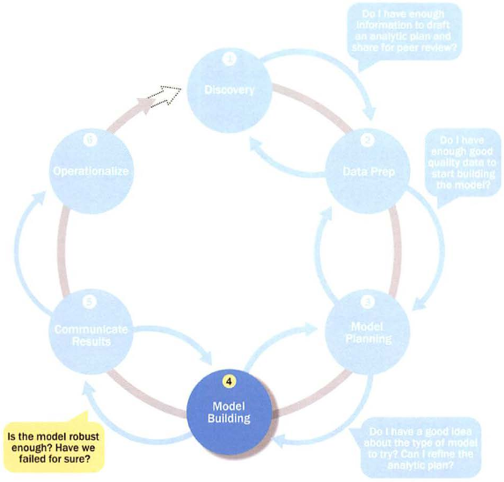
Phase 4: Model Building

Slide 79
Phase 4: Model Building
Execute the models defined in Phase 3
Develop datasets for training, testing, and production
Develop analytic model on training data, test on test data
Question to consider
Does the model appear valid and accurate on the test data?
Does the model output/behavior make sense to the domain experts?
Do the parameter values make sense in the context of the domain?
Is the model sufficiently accurate to meet the goal?
Does the model avoid intolerable mistakes?
Are more data or inputs needed?
Will the kind of model chosen support the runtime environment?
Is a different form of the model required to address the business problem?

Slide 80
Common Tools for the Model Building Phase
Commercial Tools
SAS Enterprise Miner – built for enterprise-level computing and analytics
SPSS Modeler (IBM) – provides enterprise-level computing and analytics
Matlab – high-level language for data analytics, algorithms, data exploration
Alpine Miner – provides GUI frontend for backend analytics tools
STATISTICA and MATHEMATICA – popular data mining and analytics tools
Free or Open Source Tools
R and PL/R - PL/R is a procedural language for PostgreSQL with R
Octave – language for computational modeling
WEKA – data mining software package with analytic workbench
Python – language providing toolkits for machine learning and analysis
SQL – in-database implementations provide an alternative tool

Slide 81
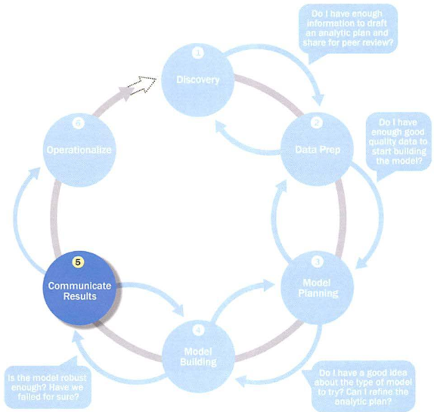
Phase 5: Communicate Results

Slide 82
Phase 5: Communicate Results
Determine if the team succeeded or failed in its objectives
Assess if the results are statistically significant and valid
If so, identify aspects of the results that present salient findings
Identify surprising results and those in line with the hypotheses
Communicate and document the key findings and major insights derived from the analysis
This is the most visible portion of the process to the outside stakeholders and sponsors

Slide 83
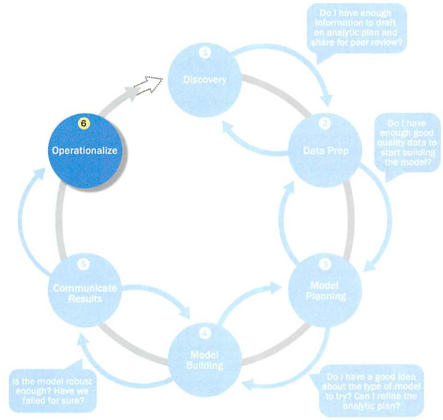
Phase 6: Operationalize

Slide 84
Phase 6: Operationalize
In this last phase, the team communicates the benefits of the project more broadly and sets up a pilot project to deploy the work in a controlled way
Risk is managed effectively by undertaking small scope, pilot deployment before a wide-scale rollout
During the pilot project, the team may need to execute the algorithm more efficiently in the database rather than with in-memory tools like R, especially with larger datasets
To test the model in a live setting, consider running the model in a production environment for a discrete set of products or a single line of business
Monitor model accuracy and retrain the model if necessary

Slide 85
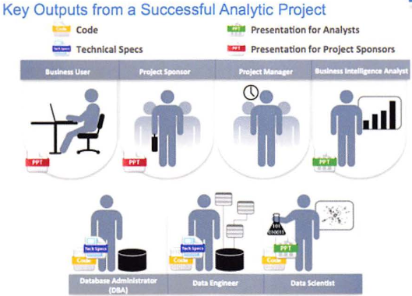
Phase 6: Operationalize Key outputs from successful analytics project

Slide 86
Phase 6: Operationalize Key outputs from successful analytics project
Business user – tries to determine business benefits and implications
Project sponsor – wants business impact, risks, ROI
Project manager – needs to determine if project completed on time, within budget, goals met
Business intelligence analyst – needs to know if reports and dashboards will be impacted and need to change
Data engineer and DBA – must share code and document
Data scientist – must share code and explain model to peers, managers, stakeholders

Slide 87
Phase 6: Operationalize Four main deliverables
Although the seven roles represent many interests, the interests overlap and can be met with four main deliverables
Presentation for project sponsors – high-level takeaways for executive level stakeholders
Presentation for analysts – describes business process changes and reporting changes, includes details and technical graphs
Code for technical people
Technical specifications of implementing the code

Slide 88
Case Study: Global Innovation Network and Analysis (GINA)
In 2012 EMC’s new director wanted to improve the company’s engagement of employees across the global centers of excellence (GCE) to drive innovation, research, and university partnerships
This project was created to accomplish
Store formal and informal data
Track research from global technologists
Mine the data for patterns and insights to improve the team’s operations and strategy

Slide 89
Phase 1: Discovery
Team members and roles
Business user, project sponsor, project manager – Vice President from Office of CTO
BI analyst – person from IT
Data engineer and DBA – people from IT
Data scientist – distinguished engineer

Slide 90
Phase 1: Discovery
The data fell into two categories
Five years of idea submissions from internal innovation contests
Minutes and notes representing innovation and research activity from around the world
Hypotheses grouped into two categories
Descriptive analytics of what is happening to spark further creativity, collaboration, and asset generation
Predictive analytics to advise executive management of where it should be investing in the future

Slide 91
Phase 2: Data Preparation
Set up an analytics sandbox
Discovered that certain data needed conditioning and normalization and that missing datasets were critical
Team recognized that poor quality data could impact subsequent steps
They discovered many names were misspelled and problems with extra spaces
These seemingly small problems had to be addressed

Slide 92
Phase 3: Model Planning
The study included the following considerations
Identify the right milestones to achieve the goals
Trace how people move ideas from each milestone toward the goal
Tract ideas that die and others that reach the goal
Compare times and outcomes using a few different methods

Slide 93
Phase 4: Model Building
Several analytic method were employed
NLP on textual descriptions
Social network analysis using R and Rstudio
Developed social graphs and visualizations

Slide 94
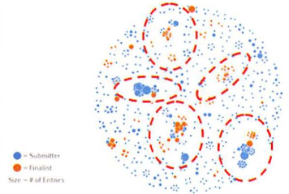
Phase 4: Model Building Social graph of data submitters and finalists

Slide 95
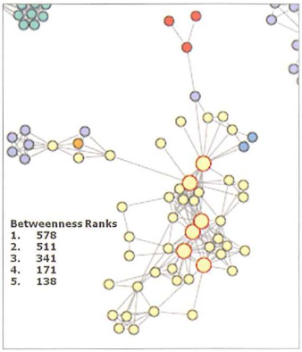
Phase 4: Model Building Social graph of top innovation influencers

Slide 96
Phase 5: Communicate Results
Study was successful in in identifying hidden innovators
Found high density of innovators in Cork, Ireland
The CTO office launched longitudinal studies

Slide 97
Phase 6: Operationalize
Deployment was not really discussed
Key findings
Need more data in future
Some data were sensitive
A parallel initiative needs to be created to improve basic BI activities
A mechanism is needed to continually reevaluate the model after deployment

Slide 98
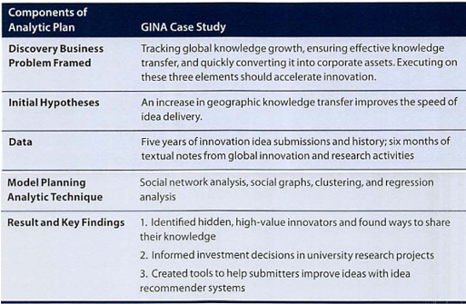
Phase 6: Operationalize

